Slide 1
Unit II
Compilers,Loaders and Linker
By – Saurabh Padmawar

Slide 2
COMPILER
Basic Compiler Functions
Phases of Compilation
Memory Allocation
Compilation Of Expressions
Compilation Of structures
Code Optimization

Slide 3
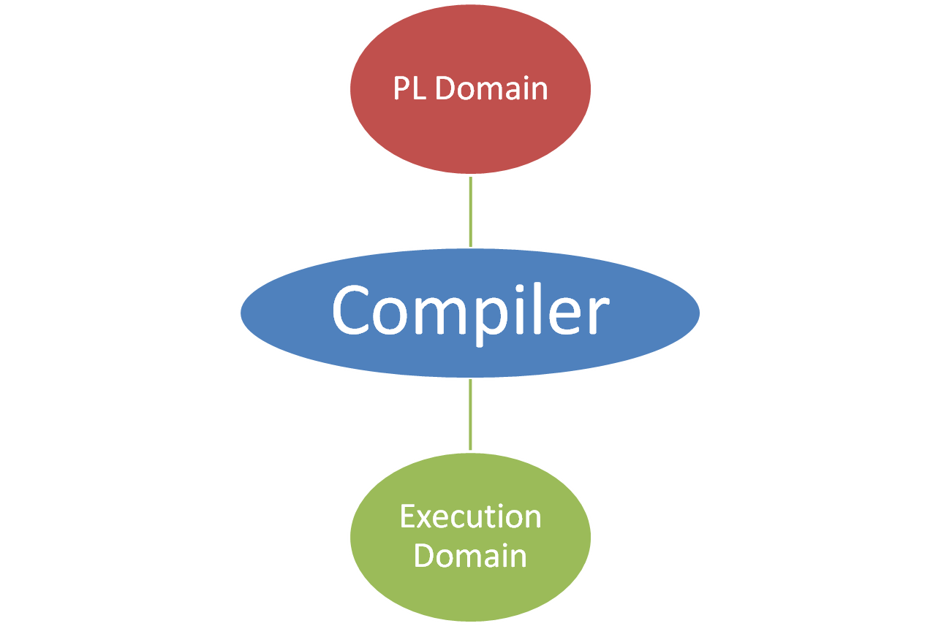

Slide 4
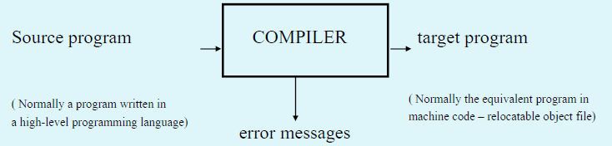
A compiler is a program takes a program written in a source language and translates it into an equivalent program in a target language.
Basic Compiler Functions

Slide 5
Other Applications………
In addition to the development of a compiler, the techniques used in compiler design can be applicable to many problems in computer science.
◦ Techniques used in a lexical analyzer can be used in text editors,
information retrieval system, and pattern recognition programs.
◦ Techniques used in a parser can be used in a query processing
system such as SQL.
◦ Many software having a complex front-end may need techniques
used in compiler design.

Slide 6
Major Parts of COMPILER
There are two major parts of a compiler: Analysis and Synthesis
In analysis phase, an intermediate representation is created from the given source program.
◦ Lexical Analyzer, Syntax Analyzer and Semantic Analyzer are the parts of this phase.
In synthesis phase, the equivalent target program is created from this intermediate representation.
◦ Intermediate Code Generator, Code Generator, and Code Optimizer are the parts of this phase.

Slide 7
Phases of COMPILER
Each phase transforms the source program from one representation into another representation.
They communicate with error handlers.
They communicate with the symbol table.

Slide 8
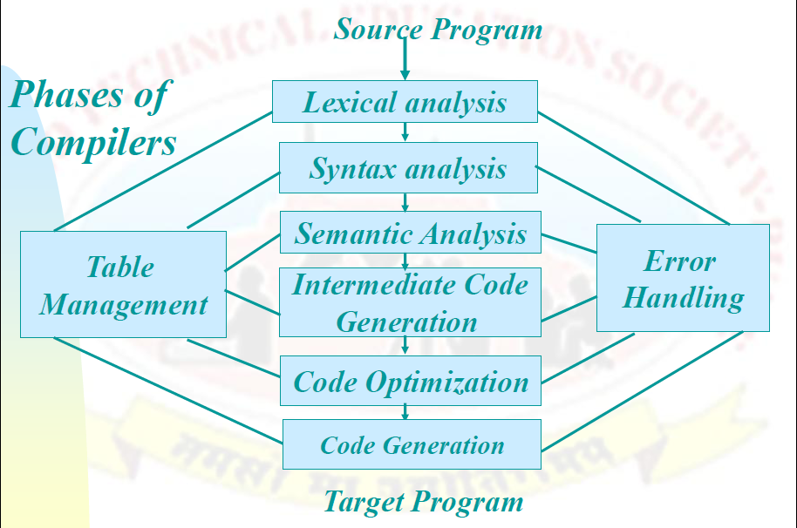
Phases of COMPILER

Slide 9
The Grouping of Phases
Compiler front and back ends:
  Front end: analysis (machine independent)
  Back end: synthesis (machine dependent)
Compiler passes:
  A collection of phases is done only once (single pass) or multiple times (multi pass)
    Single pass: usually requires everything to be defined before being used in source program
    Multi pass: compiler may have to keep entire program representation in memory
COP5621 Fall 2011

Slide 10
Compiler-Construction Tools
Software development tools are available to implement one or more compiler phases
  Scanner generators
  Parser generators
  Syntax-directed translation engines
  Automatic code generators
  Data-flow engines
COP5621 Fall 2011

Slide 11
Lexical analyzer
Lexical Analyzer reads the source program character by character and returns the tokens of the source program.
A token describes a pattern of characters having same meaning in the source program. (such as identifiers, operators, keywords, numbers and so on)
Ex:
newval := oldval + 12 ➔ TOKENS: newval identifier
:= assignment operator
oldval identifier
+ add operator
12 a number

Slide 12

Cont……
A lexical analysis on the statement.
X=Y+Z*30;
Will generate the following tokens
X is an identifier.
= is a terminal symbol.
Y is an identifier.
+ is a terminal symbol.
Z is an identifier.
* Is a terminal symbol.
30 is literal.
;is a terminal symbol.
• Identifiers are stored in the symbol table.
• Literals are stored in the literal table.

Slide 13
Cont…..
Puts information about identifiers into the symbol table.
Regular expressions are used to describe tokens
(lexical constructs).
A (Deterministic) Finite State Automaton can be used in the
implementation of a lexical analyzer.

Slide 14
Syntax Analyzer
A Syntax Analyzer creates the syntactic structure (generally a parse tree) of the given program.
A syntax analyzer is also called as a Parser.
A parse tree describes a syntactic structure.
In a parse tree, all terminals are at leaves.
• All inner nodes are non-terminals in a context free grammar

Slide 15
Syntax Analysis
=
X=Y+Z*30;
x
+
y
*
Operator as a internal Nodes
Operand as a leaf
z
30

Slide 16
Cont…..
• Syntax analysis deals with the syntax error detection and correction.
• In the program if the spelling is wrong , then in syntax analysis
the spelling is corrected according to the syntax table.
• This syntax table is the table in which for a wrong keyword in
code , the different Corrections are available.

Slide 17
Semantic Analysis
It gets the parse tree from the parser together with information
about some syntactic elements.
It determines whether the semantics or meaning of the program is
correct.
This part deals with static semantic.
◦ semantic of programs that can be checked by reading of from
the program only.
◦ syntax of the language which cannot be described in context free
grammar.
It modifies the parse tree in order to get that (static) semantically
correct code.

Slide 18
Intermediate Code Generator
An intermediate code generator
◦ takes a parse tree from the semantic analyzer
◦ generates a program in the intermediate language.
In some compilers, a source program is translated into an
intermediate code first and then the intermediate code is translated into the target language.
In other compilers, a source program is translated directly into the target language.

Slide 19
Cont….
Using intermediate code is beneficial when compilers which
translates a single source language to many target languages are
required.
◦ The front-end of a compiler – scanner to intermediate code
generator – can be used for every compilers.
◦ Different back-ends – code optimizer and code generator– is
required for each target language.
**One of the popular intermediate code is three-address code. A
three-address code instruction is in the form of x = y op z.

Slide 20
Code Generation
A code generator
◦ takes either an intermediate code or a parse tree
◦ produces a target program.

Slide 21
Code Optimization
Replacing an inefficient sequence of instructions with a better
sequence of instructions.
Sometimes called code improvement.
Code optimization can be done:
◦ after semantic analyzing performed on a parse tree
◦ After intermediate code generation performed on a intermediate
code
◦ after code generation performed on a target code

Slide 22
Code Optimization
Code Optimization aims at improving the execution efficiency of
a program.
Two ways to achieve it.
Redundancies in a program are eliminated.
Computations in a program are rearranged or rewritten to make it execute efficiently.
** No change in meaning of program

Slide 23
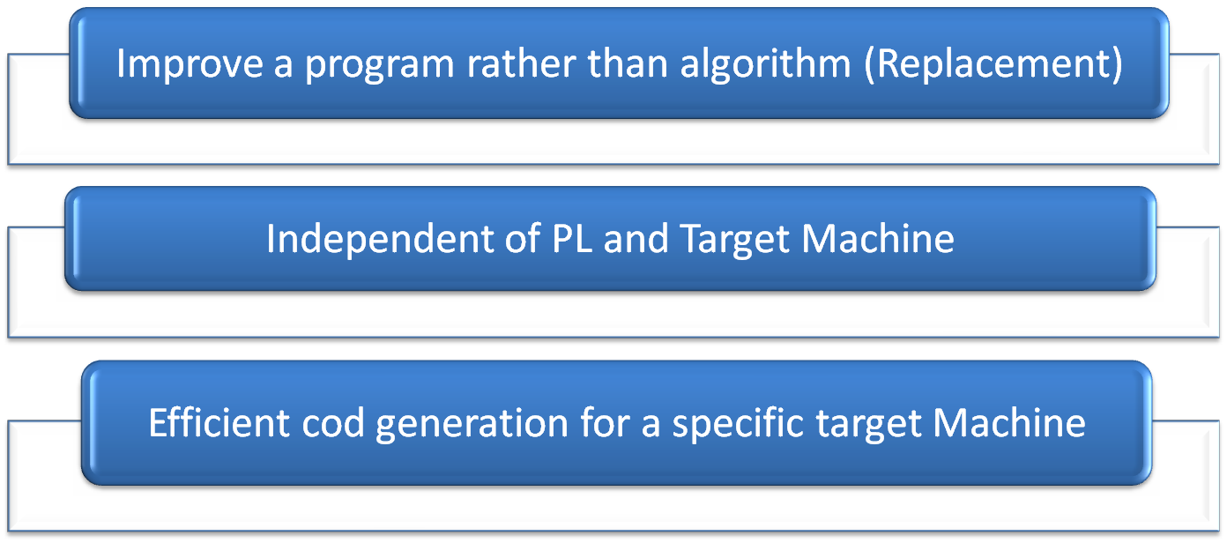
Code Optimization

Slide 24
Example:
Fortran ‘H’ Optimizing Compiler for IBM/360 system (1969)
** Consume 40% extra compilation time due to optimization.
** 25% less storage and executes three times as fast as the
unoptimized code

Slide 25
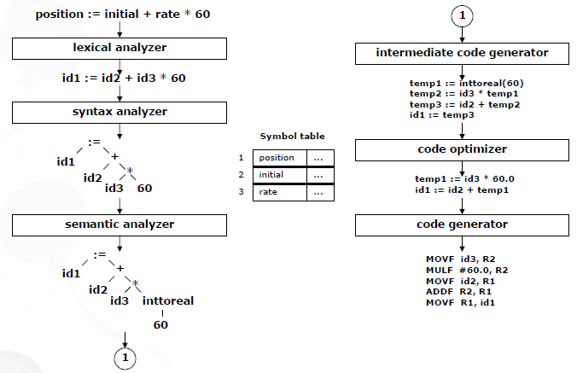

Slide 26
The Phases of a Compiler
Phase | Output | Sample
Programmer (source code producer) | Source string | A=B+C;
Scanner (performs lexical analysis) | Token string | ‘A’, ‘=’, ‘B’, ‘+’, ‘C’, ‘;’ And symbol table with names
Parser (performs syntax analysis based on the grammar of the programming language) | Parse tree or abstract syntax tree | ; | = / \ A + / \ B C
Semantic analyzer (type checking, etc) | Annotated parse tree or abstract syntax tree
Intermediate code generator | Three-address code, quads | int2fp B t1 + t1 C t2 := t2 A
Optimizer | Three-address code, quads. | int2fp B t1 + t1 #2.3 A
Code generator | Assembly code | MOVF #2.3,r1 ADDF2 r1,r2 MOVF r2,A
Peephole optimizer | Assembly code | ADDF2 #2.3,r2 MOVF r2,A

Slide 27
Memory Allocation
Static Memory Allocation refers to the process of allocating memory at compile-time before the associated program is executed.
Ex. Fortran
Dynamic Memory Allocation is automatic memory allocation
where memory is allocated as required at run-time.
Ex. Pascal , Ada

Slide 28
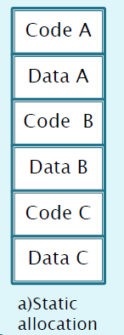
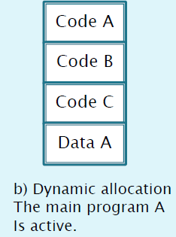
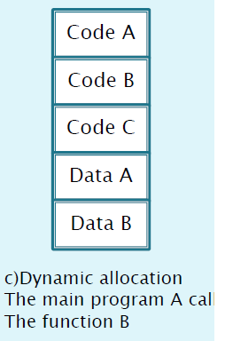
Cont…..

Slide 29
Cont….
Advantages of static memory allocation:-
• It is simple to implement.
• Binding is performed during compilation.
• Execution is faster as there is no binding during the run time.
➔Variables is directly encoded in machine instructions.
Disadvantages of static memory allocation:-
• It is almost impossible to handle recursion.
• Memory requirement is higher .
Variables remain allocated even when the Function is not active.

Slide 30
Cont……
Advantages of Dynamic memory allocation:-
In dynamic memory allocation , memory is allocated and deallocated during execution of a program.
• Dynamic memory allocation has optimal utilization of memory.
• Recursion can be implemented using dynamic memory allocation.

Slide 31
Other Tools that Use the Analysis-Synthesis Model
Editors (syntax highlighting)
Pretty printers (e.g. Doxygen)
Static checkers (e.g. Lint and Splint)
Interpreters
Text formatters (e.g. TeX and LaTeX)
Silicon compilers (e.g. VHDL)
Query interpreters/compilers (Databases)
COP5621 Fall 2011

Slide 32
Compilation of Control Structure
If (E) 100:if(E) then goto 102
{ 101 : goto 104
S1 ; 102 : S1 ;
} 103 : goto 105
Else 104 : S2 ;
{ 105 : S3 ;
S2;
}
S3;

Slide 33
Compilation of Control Structure
While (E) do 100 : if (E) then goto 102
101 : goto 105
S1 ; 102: S1
S2 ;
103 : S2
End while;
S3 104 : goto 100
105 : S3

Slide 34
Structure of Compiler
Seven distinct logical problems are summarized here:
Lexical Analysis : Recognition of basic elements and creation of Uniform Symbols.
Syntax Analysis : Recognition of basic syntactic constructs
Interpretation : Definition of Exact meaning, creation of matrix and tables
Machine independent Optimization: Creation of more Optimal Matrix
Storage Assignment : Modification of Identifier and literal tables.
Code Generation: Use of macro processor to produce more optimal assembly code.
Assembly Output : Resolving symbolic addresses and generating machine language.

Slide 35
Structure of Compiler
Databases used by compiler and form the lines of communication between the phases:
Source Code: Simple program
Uniform Symbol Table: Consists of full or partial list of tokens
Terminal Table: A permanent table which lists all key words and symbols which are present in symbolic form
Identifier table: Contains all variables in the program and temporary storage and any information needed to reference or allocate storage for them.(Created by LEX)
Literal table: All constants of program
Reductions: Permanent table of decision rules in the form of patterns for matching with the uniform symbol table to discover syntactic structure.

Slide 36
Structure of Compiler
G) Matrix: Intermediate form of the program which is created by action of routines , optimized , and then used for code generation
H) Code Productions: Permanent table of definitions.
I) Assembly Code: Assembly language version of the program which is created by the code generation phase and in input to the assembly phase.
J) Relocatble Object Code: Final Output of Assembly phase, ready to be used as input to loader.

Slide 37
Solid Lines Shows Creation of Data.
Dashed Lines shows References.
The Phases of compiler communicate by data bases.

Slide 38

Structure of Compiler
H) Code Productions
C) Terminal table
F) Reductions
4) Machine independent optimization
1) Lexical analysis
2)Syntax Analysis
3) Interpretation
5) Storage Assignment
6)Code Selection
7) Assembly and Output
A) Source Code
B) Uniform Symbol table
G) Matrix
G) Optimized Matrix
I) Assembly Code
J) Relocatble Object Code
D) Identifier Matrix
E) Literal
Table

Slide 39


